Slide 1
Components and Composition
Building a Software System from Reusable Blocks
Advanced Software Engineering 475
Andrew McVeigh

Slide 2
Food for thought...
Wider questions:
Are development tools, languages and processes biased towards creation only?
  Why do we have to predict extension points!
  Can we allow reusers to alter, but still preserve a common base?
  Is text-based version control and evolution the only solution?
  Do our languages allow too much freedom to create complex dependencies and make maintenance difficult?
  Can we do better and resolve these forces?

Slide 3
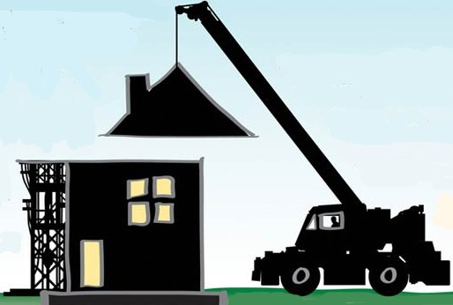
The Dream of Software Components
”Mass Produced Software Components”, 1968
  Address by Doug McIlroy, NATO Software Engineering Conference
  http://www.cs.dartmouth.edu/~doug/components.txt
  Claim: lack of prefabricated and interchangeable software parts is a sign of immaturity of software engineering
  Key idea: build software from prefabricated / interchangeable parts
  We could then make catalogues of components
    Specifications for compatibility and interchangeability
    Choose components based on properties required for system
  An industrial view of software like building construction or circuits

Slide 4
What Happened!?
Software component construction remains a compelling idea (even after 40 years!)
  Reuse components between systems
  Specifications to guarantee properties and compliance
  Component producers can specialise in certain areas
  Build systems quickly and cheaply
  *BUT*
Building software in this way proved elusively difficult
  No real agreement on what a component is!
  Small changes break reuse of components
  Lots of different environments components can live in
  Too much reliance on external components & vendors
  Software is more dynamic than other forms of construction
  Abstractions get buried as we construct, making systems brittle

Slide 5
State of Components in Industry Today...
Some (limited) successes
  COM + VBX components for rapid GUI construction
  JavaBeans for reusable application parts in Java
  Unix pipe/filter architectures
  Eclipse/OSGi for IDE components
  Interface definition languages
Some failures (opinionated view!)
  CORBA distributed objects
  J2EE components (incredible complexity, no reuse, no market)
In many ways, objects have triumphed over the idea of components
  What we call components in OO languages are often objects...
  We'll explore the differences shortly...

Slide 6
Why Then Study Components?
Construction by prefabricated components is a recurring and continuing theme
  Intuitively it seems to make sense
  It works for electronics (and that's a complex domain)
  Concepts keep appearing again and again in different forms...
What we get out of studying components...
  Gives insight into many trends in software
    modularity, abstraction, dependency injection, extensibility, architecture, analysis and more...
  Advantages over objects for many situations (”a better OO”)
    It's not an ”either-or” situation
    modern trend is for components to complement rather than replace objects... the techniques can be applied in OO languages.
  Hierarchical components are a powerful design technique

Slide 7
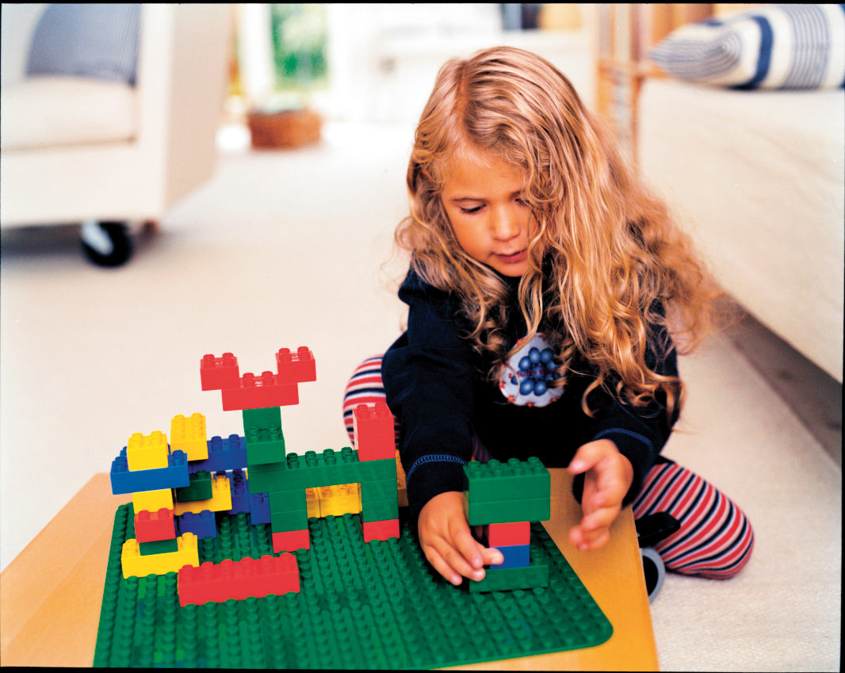
An Intuitive View Of Components

Slide 8



A Component Depends On Where You Look From...
(and who you ask!)
A component can be...
A unit for analysing a system:
Components have nice properties which allow them to be used to analyse a system. i.e. for concurrency, protocols...
A unit of composition and deployment
i.e. snap together your application from big, fat components.
analysis ► design ► deployment
A unit of design in a system:
Units which can be composed and reused within a design.
This forces architecture to be explicit.

Slide 9
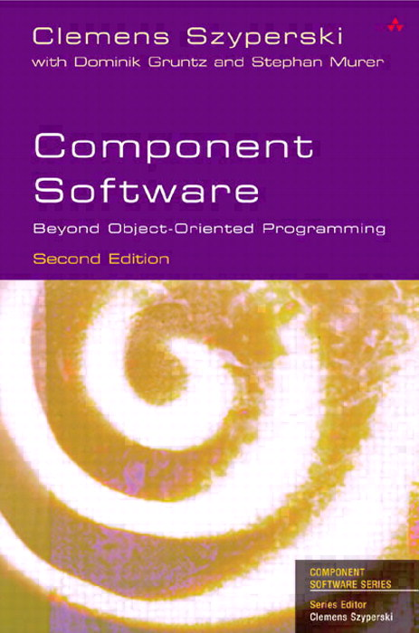
Component Consensus?!
The different perspectives have resulted in many different notions of ”component”
Possibly the most ”popular” definition is from Syperski's Component Software Book
A component:
  Is a unit of independent deployment
  Is a unit of third party composition
  Has no persistent state
Confused yet?!
(I didn't find it helpful either...)

Slide 10
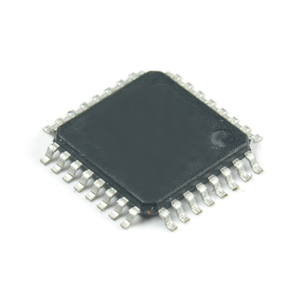
Developing an Intuition for Components
Consider an electronics metaphor
  we use this to build out an intuitive component model for software
Let's start with a chip...
Each chip is an instance of a design / template
It has interfaces (pins) describing its interaction with the rest of the world, and a specification
  Substitution, compatibility
Interfaces describe what it provides and requires fully
  It is context independent!
Interface pins
Chips has a specification
and a design,
we can make more

Slide 11
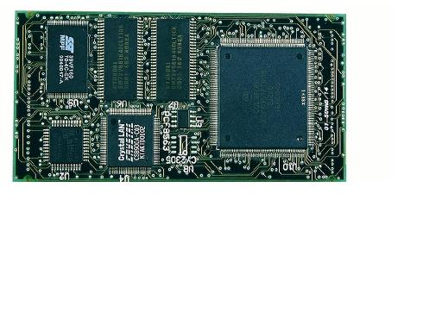
Wiring up a Circuit Board
We can now wire up some of these chips into a larger circuit... thereby forming a ”composite”
We could hide the insides and pretend it's a big chip!
Two instances of the same chip
Circuit has a specification,
and a design,
we can make more
Interface pins
Chip that has been wired up
Circuit board and wiring (tracks)

Slide 12
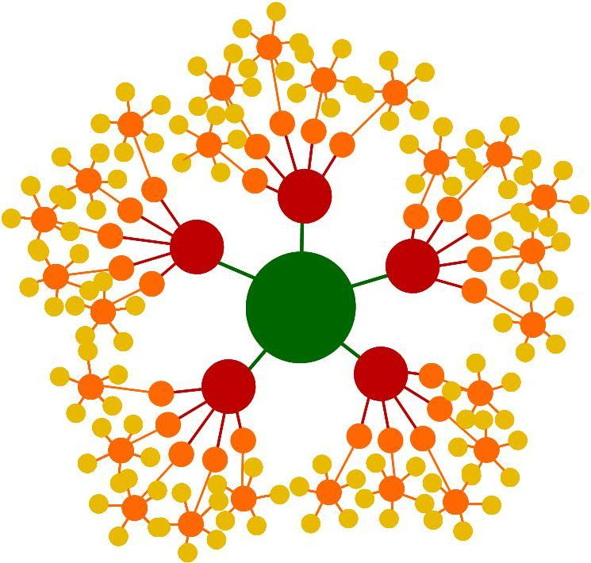
Thinking about Circuits and Chips...
Just imagine if we could magically shrink the (populated) circuit board down to chip size...
  Actually, this is sort of what tends to happens over time anyway...
  We could then use it just like a chip
  If we could do this, there would be no difference between a circuit board and a chip
  We can effectively build up higher and higher levels of abstraction by building circuit boards with higher level ”chips”
This is a fractal model
  The essential form of a circuit / chip
  is the same from any level of
  abstraction

Slide 13
A Hierarchical Model of Circuits...
Consider that we have a composition hierarchy!
Note that a circuit board has no ”smarts”: it's the chips!
    It is just a wiring up of other chips (or circuit boards)
    We can make an identical circuit by wiring up the leaf chips directly!
wire
circuit board
chip
circuit board
higher abstraction
chip
chip
circuit board
chip
chip
circuit board
chip
chip
chip
chip

Slide 14
So, How Does This Help?
analysis ► design ► deployment
Analysis:
  Each circuit or chip can be analysed at its interfaces: a black box
  Communications between internal parts are hidden
  The action all happens in the chips at the bottom of the hierarchy
Design
  We build circuits by composing other circuit boards and chips
  This raises the level of abstraction, giving us more power
  The architecture is explicit. We know what connects to what.
  We can test each component in isolation (context independence)
Deployment
  We plugin chips into our circuit boards
  We sell chips and also circuit boards, both populated and not...

Slide 15
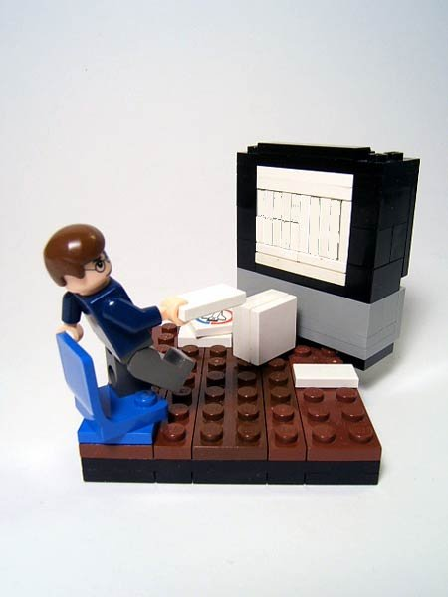
Applying Component Ideas To Software

Slide 16
Software Components
Let's apply these intuitions to software
  We want to be able to create software out of reusable blocks
  We want to have explicit architectures and be able to analyse
We also get some other advantages...
  Software is more flexible than physical electronics
    i.e. We can automatically ”shrink” a ”circuit” down to a ”chip”
  We don't worry about physical effects such as transmission speed
    except in distributed systems where this becomes important again...
  Instantiating software components is cheaper than instantiating circuits and chips
We also get some disadvantages over normal s/w...
  We need to ”limit” some aspects of software to fit into the component model and to ensure an explicit architecture

Slide 17
Leaf: A Software ”Chip”
A leaf component is a ”chip design”
  It has interfaces to show what is provided and required
  It can also have properties (attributes) which hold state
  We can instantiate it as many times as required
  It is not decomposed further into smaller parts
public class Leaf
{
public int attribute = 5;
private Interface port1 =
new Interface()
{
...
}
};
public Interface getPort1()
{ return port1; }
private Interface port2;
public void setPort2(Interface i)
{ port2 = i; }
}

Slide 18
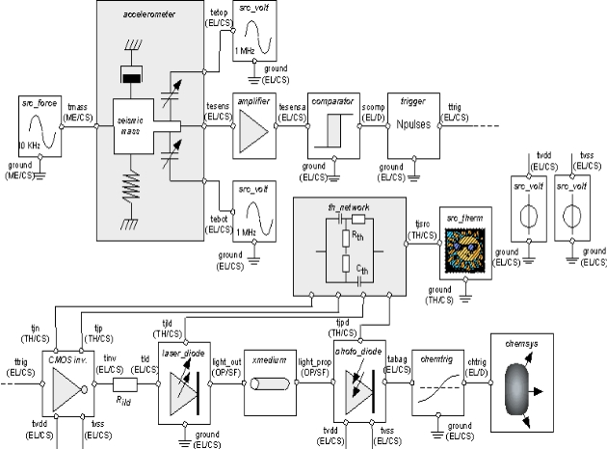
Leaf: A Software ”Chip” (2)
The class is a ”chip design”
  Each ”chip” is an instance of the class
Chip design
Software component
public class Leaf
{
...
}
used to create
instances
used to create
instances
Chip
Part (component instance)
new Leaf();

Slide 19
Composite: A Software Circuit
A composite component is a ”circuit board design”
  Connects up a component instances into a new component
public class Composite
{
private Leaf a = new Leaf();
private Leaf b = new Leaf();
public Composite()
{ a.setPort2(b.getPort1()); }
public Interface getPortA()
{ return a.getPort1(); }
public void setPortB(Interface i)
{ b.setPort2(i); }
}
NOTE: no actual logic is needed in this class
Perhaps we could generate it from pictures?

Slide 20
Composite: A Software Circuit (2)
No logic in the composite class
  Just connections and delegated calls
  Can also have attributes, but these are mapped onto leaf attributes
So, we can generate this class from the diagrams
Or we can go one better
  Any hierarchy turns into connections between leaf instances, just as any complex circuit board turns into connections between chips
  We can instantiate the leaves and connect them up using reflection from the diagram
Good things come from composites with no logic...
  No expressive power is lost
  They are effectively just wiring instructions, like a circuit board

Slide 21
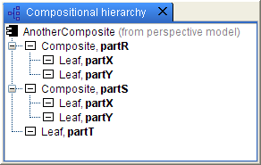
Composites Of Composites...
We can now use our Composite to make a new component
Turns into just 5 leaf parts
connected together...

Slide 22
How Does The Model Help Us?
The full model is very simple
  A component is a unit of instantiation that specifies all services provided and required via interfaces
  Compose new components by connecting together instances of other ones
What do we get out of this hierarchical model?
  Chimes with an intuition about how to ”construct” software
  A simple, but complete and we can use it to assess other models
    Gives great insight into their limitations and strengths
  Also gives insight into OO limitations and strengths
We can map this onto many technologies and contexts
  The core ideas remain the same
  We can add: distributed communications, different languages
  Can be used for analysis (FSP), design, deployment (more later)

Slide 23
Differences from OO
As we have seen, a class can be a leaf component
  i.e. we can use an OO class as a component, with constraints
  It must indicate all provided services via interfaces
  (often done in OO)
  It must indicate all require interfaces
  (rarely done in OO consistently, but more common with DI)
All component instantiation is via composites
  This is a big difference
  Essentially, all ”new”s must go from code and are pushed into the configuration → a modern trend also in dependency injection
  Makes the system architecture very explicit
  No passing around of component references, all communication must be done via connectors
  Dynamic component instantiation will be discussed later

Slide 24
History of This Approach
Conic / Darwin from Imperial
  Inspiration behind Microsoft COM and others
ROOM from ObjectTime
  Model is now part of UML2 (complex story)
Most component models get it (often subtly) wrong...
  Some don't allow multiple component instances
  Or they allow composites with behaviour (e.g. UML2, Spring) or don't support composites at all (JavaBeans)
  Or they don't provide connectors (COM, Spring, JavaBeans etc)
  Or they use a registry for component instantiation (COM, EJB2, Eclipse), making models indirect and evolution tough (DLL hell!)...

Slide 25
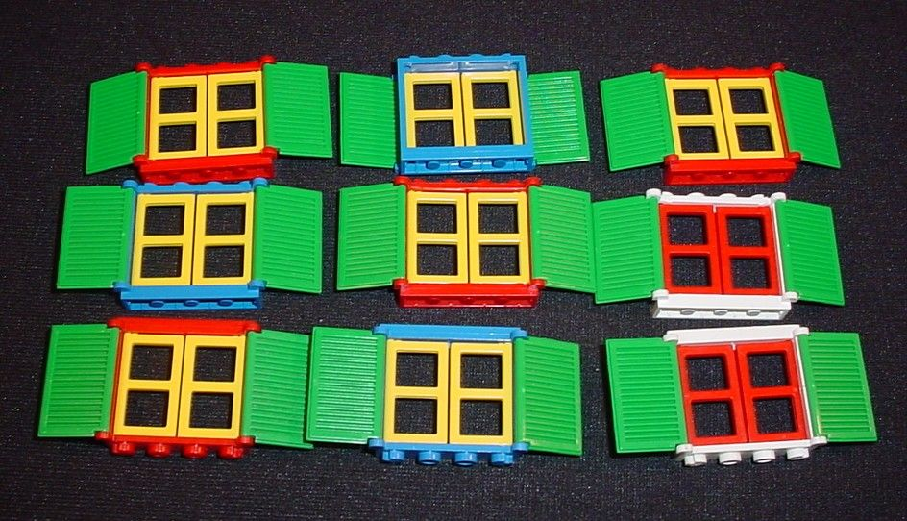
Example: A User Interface in GWT

Slide 26
GWT and Components
Google Web Toolkit is a Java to JavaScript UI library
  Write GUIs in Java, in a similar way to Swing, Winforms etc.
  This is translated to JavaScript and run in a browser
  Let's see if we can apply components in this exotic setting?!
First, we need to represent the JavaBeans in GWT
  The beans turn into leaf components; mapping is neat and simple

Slide 27
Making A Composite Name Widget...
We can now connect up instances to make a UI
  Name widget: first name, last name

Slide 28
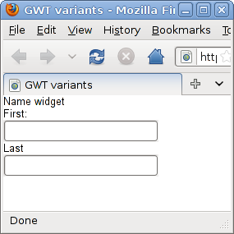
A Composite Name Widget... (2)
The result...

Slide 29
Making a Composite Address Widget
Address widget: street, town

Slide 30
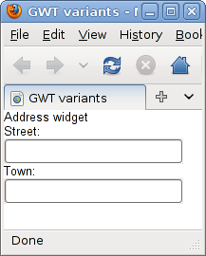
A Composite Address Widget (2)
The result

Slide 31
Composing Further: name and address

Slide 32
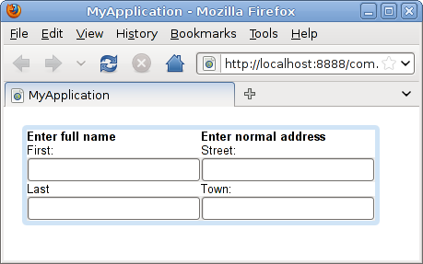
Composing Further (2)

Slide 33
What Are We Achieving?
Creating composite structures
  We are building higher level widgets without writing code
  Without needing any special UI patterns or facilities
  Connectors used for joining up widgets
  Connectors also used for connecting event sources to sinks
  Architecture is completely explicit
GWTCustomerWidget
NameWidget
DecoratorPanel
HorizontalPanel
AddressWidget
HTML
Label
TextBox
Label
TextBox
V.Panel
HTML
Label
TextBox
Label
TextBox
V.Panel

Slide 34
Tutorial Demonstration...

Slide 35
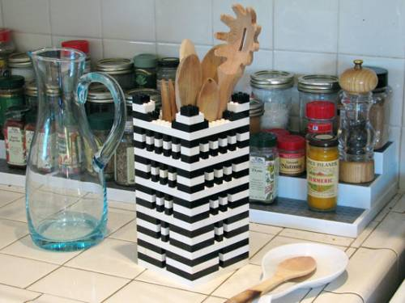
Component Reuse, Adaptation and Extension

Slide 36
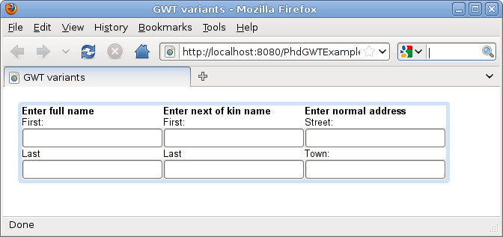
Component Reuse
Great, we've got lots of reusable widgets
  We can combine them in different ways to make different Uis
  E.g. Let's make a new composite with two name widgets and an address

Slide 37
Problems Afoot...
Can we reuse GWTCustomerWidget?
GWTCustomerWidget
NameWidget
DecoratorPanel
HorizontalPanel
AddressWidget
HTML
Label
TextBox
Label
TextBox
V.Panel
HTML
Label
TextBox
Label
TextBox
V.Panel
Hmm: We would have to add something right into the
middle of an existing composite

Slide 38
What Are Our Choices?
We want to adapt GWTCustomerWidget for reuse
But...
  We don't want to just change it, because it will break it for existing users who want it to stay as it was...
So, instead...
  We ”peel back” the hierarchy to the point where we can make our changes
  We then reuse components from this level
GWTNextofKinCustomerWidget
Reuse from here down...
NameWidget
NameWidget
DecoratorPanel
HorizontalPanel
AddressWidget

Slide 39
But This Is Not Ideal...
We've reused bits, but now have problems
  GWTCustomerWidget and GWTNextOfKinWidget are similar
  What if someone changes/upgrades GWTCustomerWidget?
    Perhaps to fix up a bug?
    We won't get that fix in GWTNextOfKinWidget
We are ”burying abstractions” as we build higher level ones → and the building comes tumbling down...
We just want to change this!
But we end up throwing away
the whole structure!

Slide 40
Adapt the Component to Reuse it?
Fred: Reuser
I got my changes, but
component logic has
changed!!!
Lily: Reuser
I got the component
logic changed, but
lots of extra changes too
Bob: Reuser
I got my fixes, but
lots of changes ==
lots of work for me!
Version 1.0
Version 2.0
Changed required interface
Kim:Component dev
I'm overworked and
underappreciated!
Changed logic
Added required interface

Slide 41
Adapt the Component To Reuse It? (2)
Edit the definitions to make the change?
  It breaks it for existing users
”Wrap” the component and reuse it via delegation?
  Only works for certain changes, and it's a bit of a hack...
Make it more general so that it could cope with all scenarios?
    Existing users have to change code to cope
    Existing users would at least have to retest: often a big problem
    If we did this for every change, we'd get a completely generic mess
    Do we even have write access to the definitions to do this?!
We could copy and paste (or fork), and then edit
  But this creates a (big) maintenance problem||
NOTE similarity to a framework!!

Slide 42
So, What's the Answer for Reuse?

Slide 43
Resemblance
Define a new component in terms of similarity
all other structure
is ”inherited”
added part
and connector
only

Slide 44
Resemblance (2)
Resemblance keeps changes as ▲'s
  We get to remake the inherited structure
  But we don't destroy or alter the original
  Easier to see in textual form...
Consider
  If GWTCustomerWidget is altered, the changes will propagate
  We've made the change without source code access or changes
  We can add, delete or replace inherited structure
component GWTNextOfKinCustomerWidget
resembles GWTCustomerWidget
{
parts:
n: GWTNameWidget
text = "<b>Enter next of kin name</b>";
connectors:
c joins panel@n to _widgets@h;
}

Slide 45
Resemblance (3)
Resemblance would not work well if each composite had its own behaviour
  As a composite is just a set of wiring instructions, resemblance can work at a purely structural level
But, what if we want deep changes?
A
Want to change E to F,
only in the hierarchy
of A
Do this in 2 stages:
Define NewC resembles C
replaces E part with F part
Define NewA resembles A
replaces C part with NewC part
Any change can be accomplished this way...
B
C
D
E

Slide 46
Reuse via Resemblance
We can remake the structure of anything
  Add / Delete / Replace connector, parts, attributes, ports etc
  All structure is in ”wiring” so change is simple
  No limitations of inheritance → overrides and adds only
All instances are described in the structural model
  No complex OO code that allocates objects
  This limitation of removing ”new”s from code is necessary to give this power
  This is a modern trend, as ”new”s in code prevents unit testing

Slide 47
Component Reuse via Resemblance
Fred: Reuser
I can add my extension
point
Lily: Reuser
I can change the logic
and an extension point
Bob: Reuser
I can make the fixes
myself or pick them up.
No changes I don't want...
▲
▲
▲
Kim:Component dev
What the problem is?
+
Fix stratum
Version 1.0

Slide 48

Component Evolution

Slide 49
Modelling Component Evolution (1)
Consider how a component evolves
  Composite components change structure
    Attributes, ports, connectors, parts
  Primitive components change structure and implementation
    Attributes, ports, implementation (held as a structural field)
We already have the building blocks for modelling changes in structure → Resemblance
  Require one more simple concept for modelling evolution

Slide 50
Modelling Component Evolution (2)
Resemblance allows us to inherit structure and change it
Hmm, we could push back the definition and use it to replace the previous one: replacement
  This models component (and system evolution)
A
NewA
resembles
B
C
B
C
D
replaces
This is the evolved component.
Even has a name change!
A
EvolvedA
resembles
B
C
B
C
D

Slide 51
Replacement
We can replace and old definition with a new one
  Anything that referred to the old, now refers to the new

Slide 52
Strata for Organising Components
Need a way to group components
  In a large system we may have thousands of components
  Composition is not enough to organise
  Need a way to deploy such that the original component is kept separate from its evolution – we can refer to both that way...
A stratum groups definitions (like a module)
  GWTAddress + GWT
  == original system
  Evolution + GWTAddress + GWT
  == evolved system

Slide 53
Strata Are the Unit of Deployment
Strata must declare their dependencies & group many related definitions
  We use this as a unit of deployment
  Via replacement, a stratum can evolve the system it is added to making this an excellent extensibility approach
  We can only add strata if its dependencies are already present
  Can be nested if a single stratum is too fine-grained
Single components are not a good deployment mechnanism
  Forces components to become coarse-grained and fewer to avoid architectural management issues
  Some other approaches have worked this out
  E.g. JavaBeans uses JAR files

Slide 54
Application Extensibility
Resemblance, Replacement and Strata
  Form an excellent extensibility model
  A stratum can alter any aspect of the system it is added to
  We can check for well formedness
  Multiple, independently developed strata can be combined
  Further strata can correct any errors from combining
Different combinations result
in different variants...

Slide 55
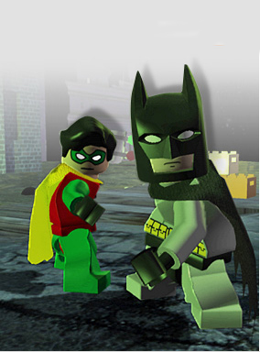
Dynamic Component Instantiation

Slide 56
What is a Dynamic Change?
A change made on demand to the structure
  Programmatic; maybe on reaction to a UI event
  Respects the architectural description
  Described in the component model
Introducing isomorphic factories...
  A component whose parts and connectors are lazily instantiated
  Uniform treatment of components; resemblance, replacement

Slide 57
Dynamic Instantiation via UI Event

Slide 58
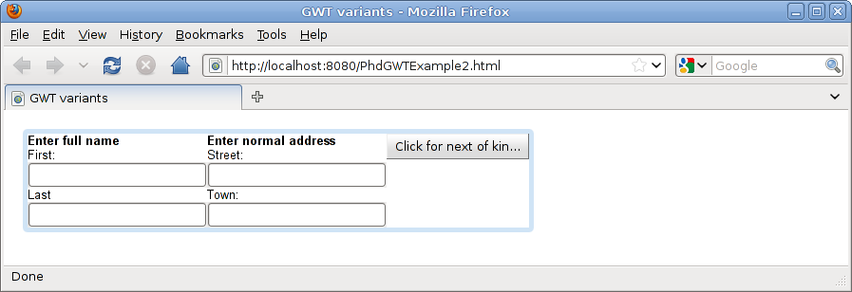
Before Clicking on the Button...

Slide 59
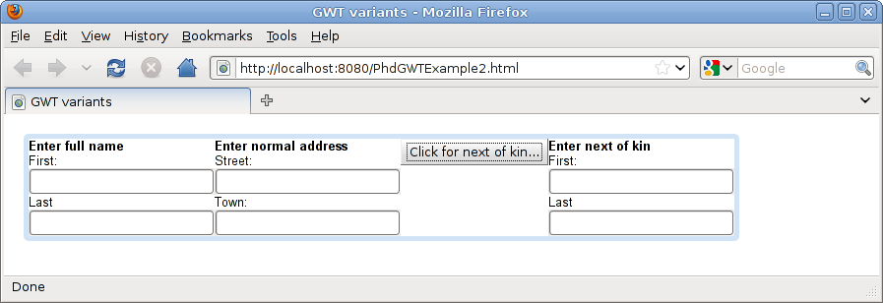
After Clicking Once...

Slide 60
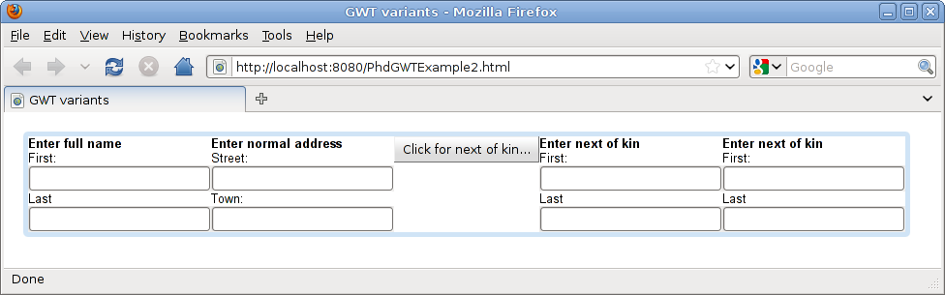
After Clicking Twice...
You get the idea ;-)

Slide 61
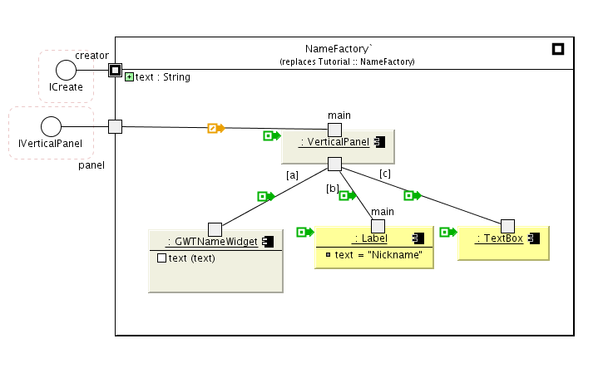
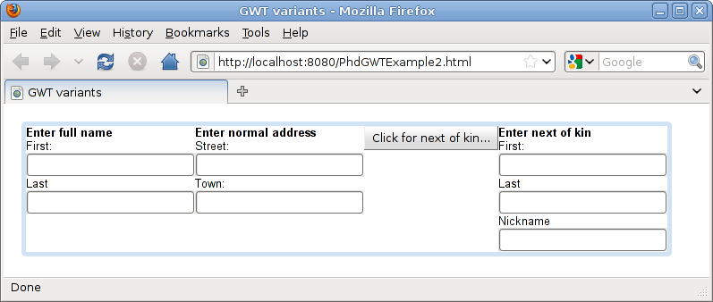
Factories are components → Evolution

Slide 62
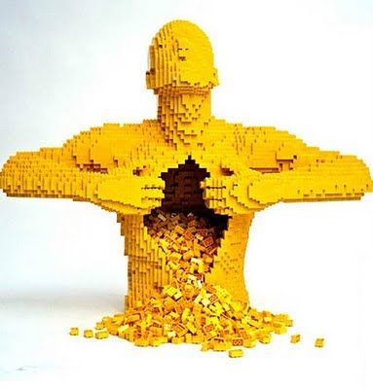
Checkpoint Summary

Slide 63
Summary: Our Component Model
Interface indicates a service contract
Component is a unit of assembly
  Can be ( multiply) instantiated inside another component
  Explicit about all provided and required interfaces via ports
  Allows a composition hierarchy
  Composite components are simply wiring instructions
  Leaf components must be ”implemented”
  Dynamic architectural changes via components with lazily instantiated parts
Stratum / Module is a unit of deployment
  Groups related definitions and selectively exports these
  Possibly nested, with explicit dependencies on other strata

Slide 64
Summary: Our Component Model (2)
Resemblance
  Define a component (or interface) in terms of similarity to others
  Like a structural form of inheritance
  Subtype relation holds if no delete or replace deltas
Replacement
  A component from one stratum can replace another in an ”earlier” stratum
  Allows incremental evolution when combined with resemblance
  A simple and elegant model
    Can map onto many technologies
    We can use it to assess other models

Slide 65
Food for thought revisited...
The questions that I asked earlier:
Are development tools, languages and processes biased towards creation only?
  Why do we have to predict extension points?
  Can we allow reusers to alter, but still preserve a common base?
  Is text-based version control and evolution the only solution?
  Do our languages allow too much freedom to create complex dependencies and make maintenance difficult?
  Resolving these forces can be achieved with a strong component model → Difficult to get correct, as we see far too often...

Slide 66
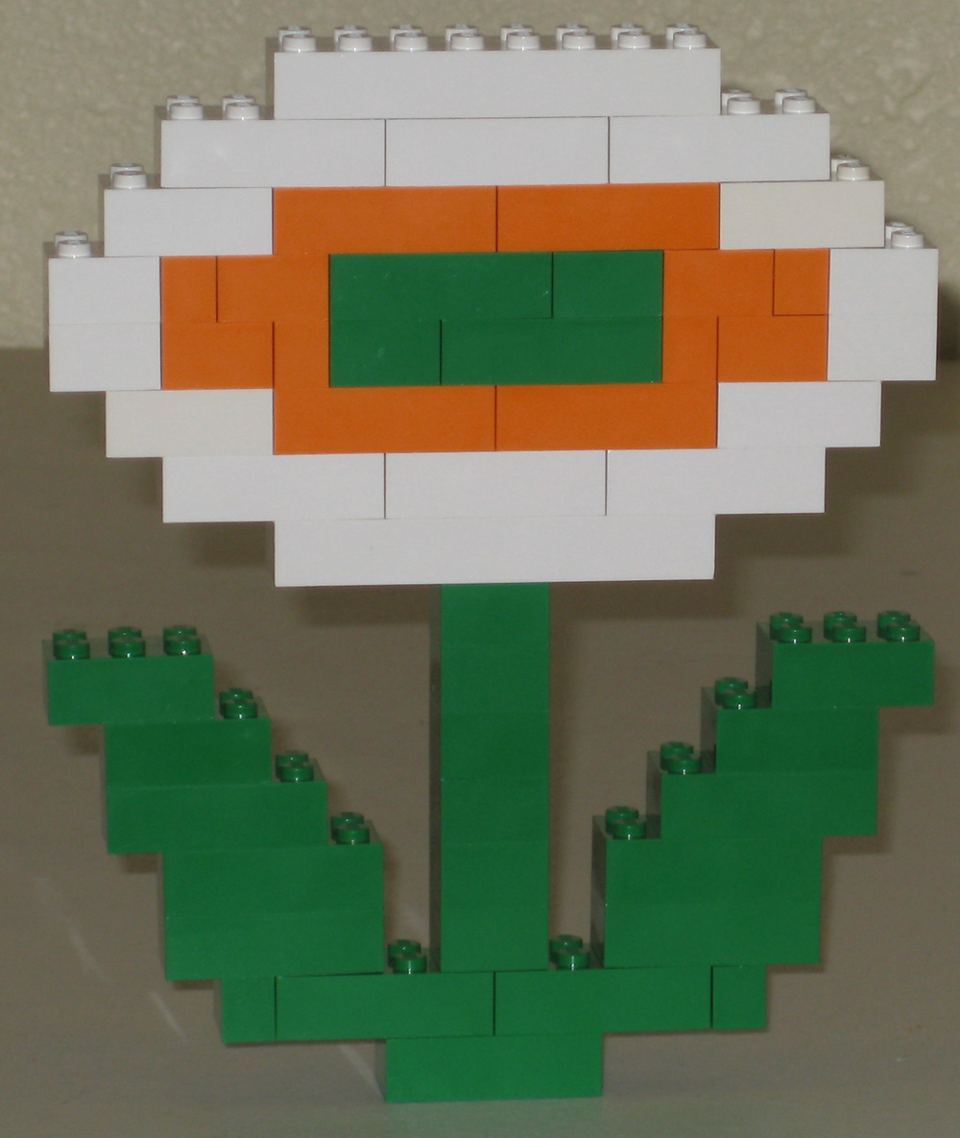
Industrial Component Models (1):
JavaBeans and Spring: Coping Without Connectors

Slide 67
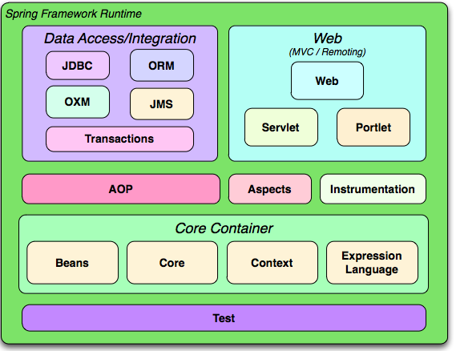
The Spring Framework
Core of Spring is a dependency injection framework
  Widely used in enterprise Java
  Based on JavaBeans: wires up instances of beans
  Everything builds on this foundation: let's analyse it!

Slide 68
Building on JavaBeans
What is a bean?
  How does it compare to our ”leaf” components
  JavaBean is a subset...
Limitations:
  1 port only for provided interfaces i.e. what the class implements
  Each other port must have a single required interface
  Attributes cannot be aliased

Slide 69
Wiring up JavaBeans Using XML
<bean id="exampleBean" class="examples.ExampleBean">
<property name="beanOne">
<ref bean="anotherExampleBean"/>
</property>
<property name="beanTwo" ref="yetAnotherBean"/>
<property name="integerProperty" value="1"/>
</bean>
<bean id="anotherExampleBean" class="examples.AnotherBean"/>
<bean id="yetAnotherBean" class="examples.YetAnotherBean"/>
Consider composites
  There are no explicit instances, and hence no explicit connectors
  Require an implementation class!
Any bean can be marked as ”prototype” or ”singleton”
  prototype → create a new instance each reference
  singleton → use the same instance everywhere
A composite bean
can refer to others...
Introduces a bean
NB: no need to describe
attributes here...

Slide 70
Configuring Complex Structures?
This example is fine
  it's a tree with a single connect to each instance!

Slide 71
Configuring Complex Structures (2)
This example is not ok
  Button, ClickLogic etc would have to be singletons!
    But they really shouldn't be...
    Interacts badly with Spring dynamic instantiation

Slide 72
Can we get around the limitations?
Not easily...
  Can express instances that form tree structures
  Can only have a single ”implicit” connector to each
  *UNLESS*
  We mark the bean type as ”singleton”
  Then if we need more than one, we have a problem
Insight:
  We can introduce lots of redundant singleton beans and then we can flatten and use Spring to wire the flattened structure
  However, then we lose the ability to dynamically instantiate
  Not really the way it is supposed to be used

Slide 73
Summary of Spring
JavaBeans is a decent, if simple component base
Spring can wire up simple tree instances ok
  Beyond this we hack or find workarounds
  No explicit instances or connectors
  Another big limitation is the need for even composite beans to refer to an implementation class...
Things not discussed:
  Have a form of bean inheritance: can replace but can't delete
    Interacts badly with composite beans needing classes
  AOP: Interesting way of ”adjusting” a model
    Creation and extension are not uniform
  Still a very useful approach in practice, but built on a weak base

Slide 74
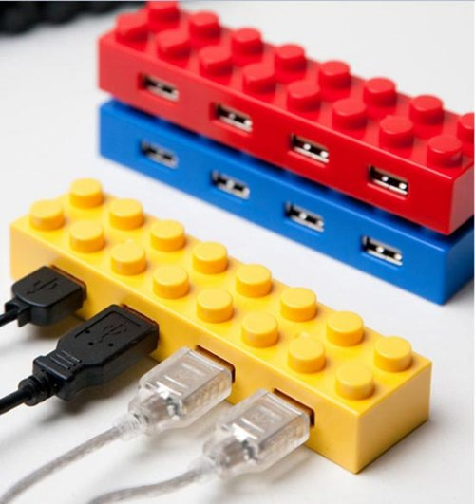
Industrial Component Models (2):
The Eclipse Plugin Model
(or mixing up components and modules)

Slide 75
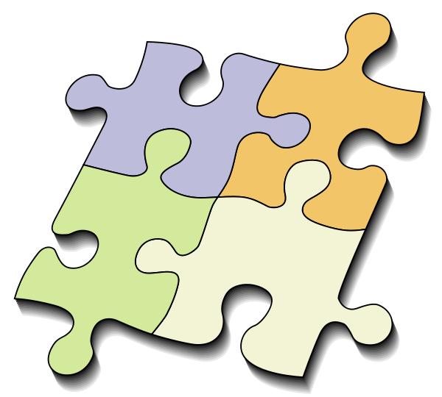
The Eclipse Plugin Framework
A plugin is a collection of classes, interfaces and XML
  Plugins declares extension points
  A plugin can extend other plugins
  A plugin in instantiated once
  It controls what is exported
It is a component!
Or, is it a module?
Provided interface
Required interface
Each plugin has a version

Slide 76
Strangeness
Class names are passed to extension points
  To extend an extension point, a plugin passes it a class name
  The plugin then instantiates the class
  So, classes are a bit like components too: multiple instantiation
Insides of a plugin are opaque without the source code
  Can only utilise exported extension points
  What if we require another extension points?
    We need to create a new version!
    Leads us back to the framework evolution problems
    Plugins can be very big, new version is lots of work
    What if multiple parties create a new version each?!

Slide 77
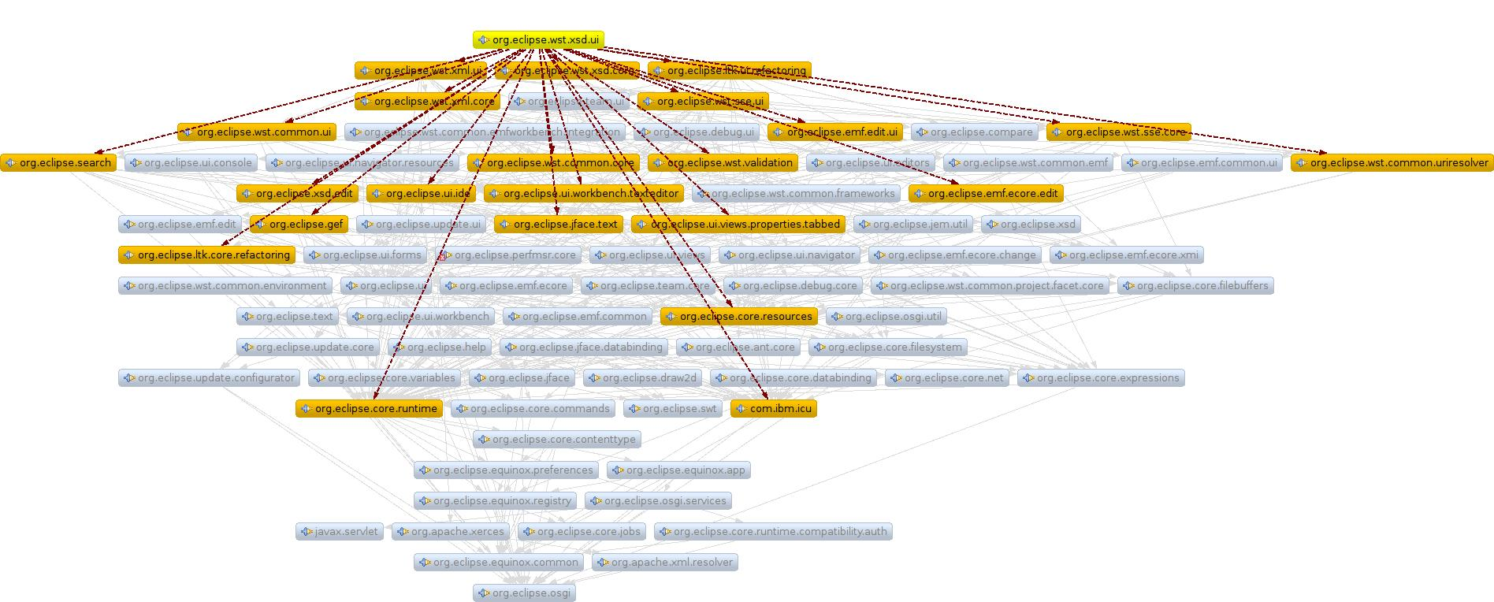
Further Strangeness
Plugins are not truly hierarchical
  They have names which can be used like Java packages
  A complex Eclipse installation will have 500+ plugins
  Difficult to understand the architecture by looking at the plugin dependencies

Slide 78
Eclipse Plugin Model Summary
Plugins
  Have provided and required interfaces
  Have a powerful version approach
  Act a bit like components and modules combined
  Tend towards coarse granularity because there is no nesting
  Can only be instantiated once
  Rely on a strange class name approach for extension
Limitations
  Replacing a plugin requires source code and can be a big job
  Can't make a breaking change, as it might cascade
    Plugin registry leads to ”plugin hell”
  Forces discourage others from making changes to plugins they do not own...
    i.e. To any Eclipse foundation plugins :-(

